Slide 1
DSCI 553 Foundations and Applications
of Data Mining
Professor Wei-Min Shen
University of Southern California
Thanks for source slides and material to:
J. Leskovec, A. Rajaraman, J. Ullman: Mining of Massive Datasets
http://www.mmds.org

Slide 2
Outline
Introduction of Teaching Team
About This Course
Introduction to Data Mining
Map-Reduce (Part I)

Slide 3
DSCI-553 2022-S Teaching Team
Professor Wei-Min Shen
Office Hours
After Lecture (by email appointment)
Teaching Assistances and Course Producers
Office Hours
See Blackboard and Piazza (resources/staff)

Slide 4
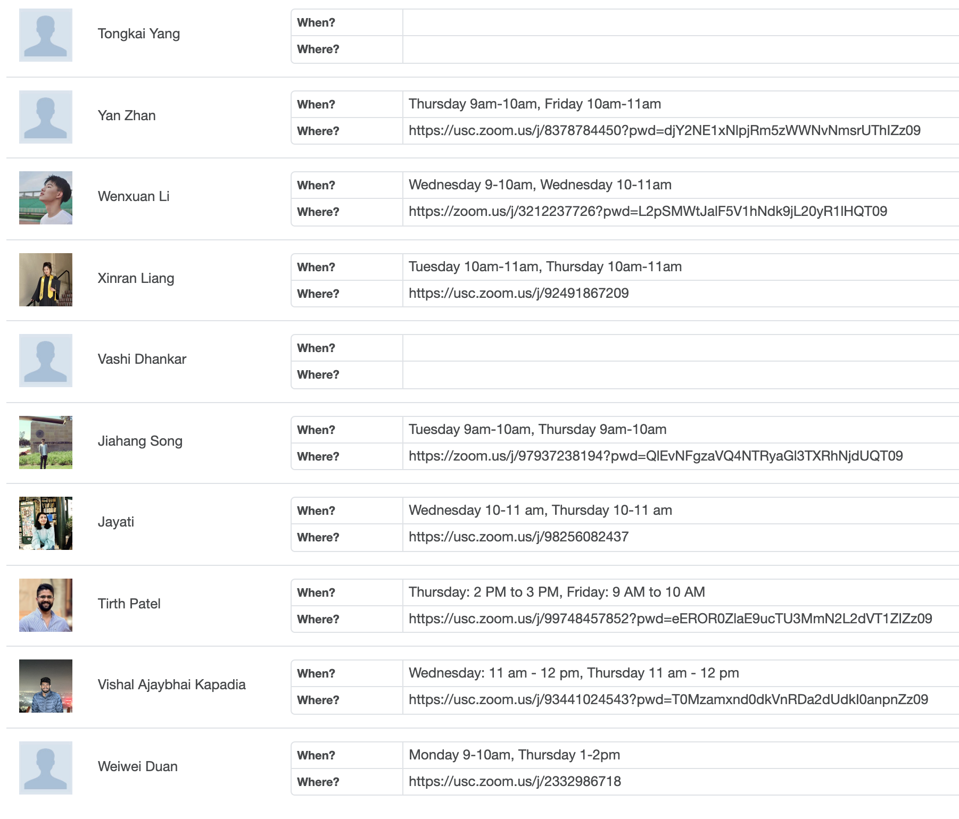
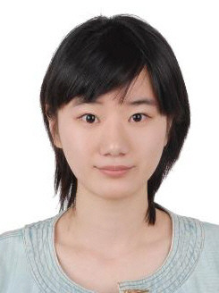
DSCI-553 2022-S Teaching Team

Slide 5


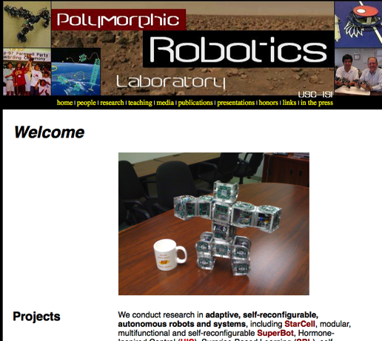
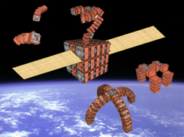
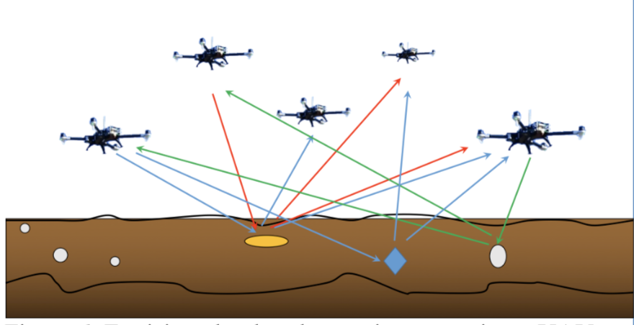
USC Polymorphic Robotics Lab http://www.isi.edu/robots
Transformer Robots: Self-Reconfigurable & Modular
Surprise-Based Learning
Teaching
CS561 (AI)
CS360 (AI)
DSCI-552
DSCI-553

Slide 6
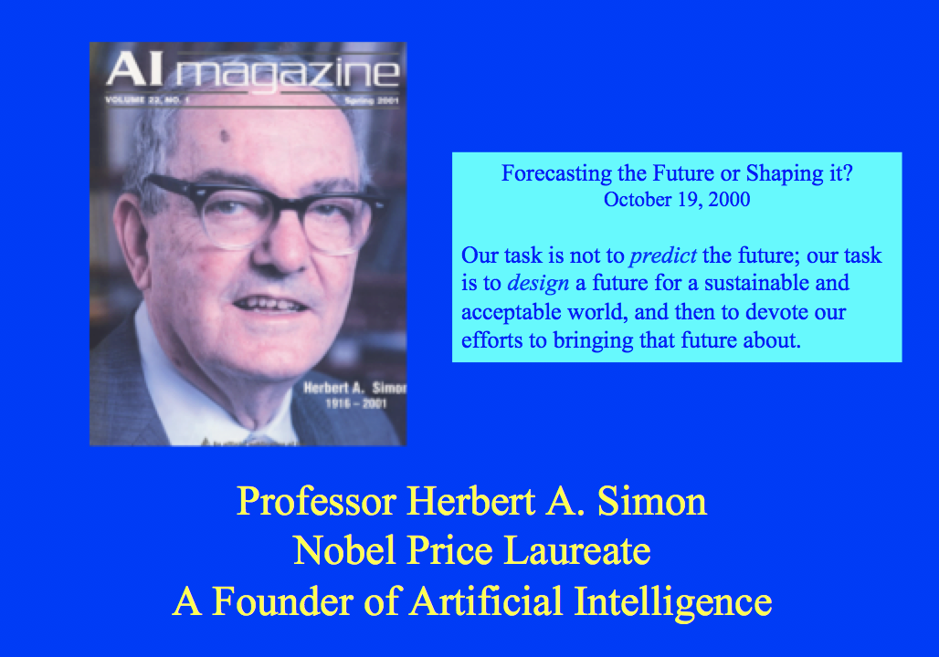
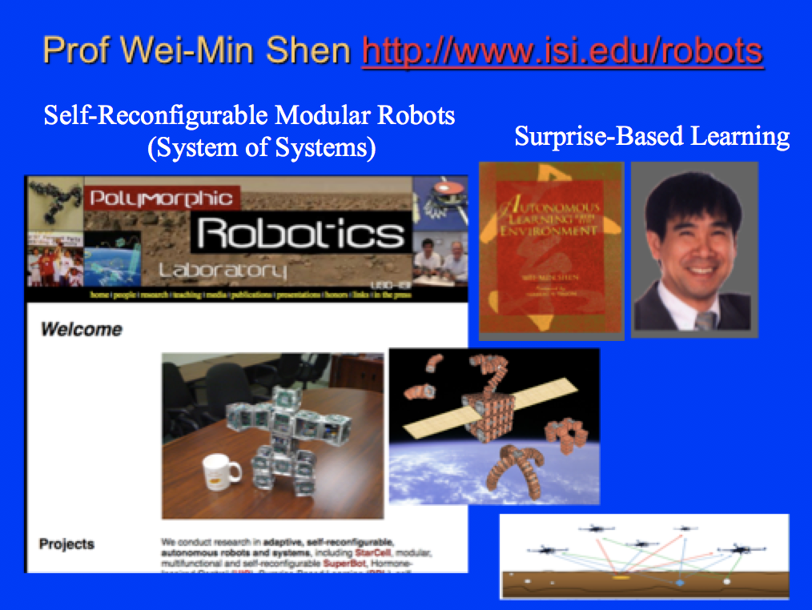
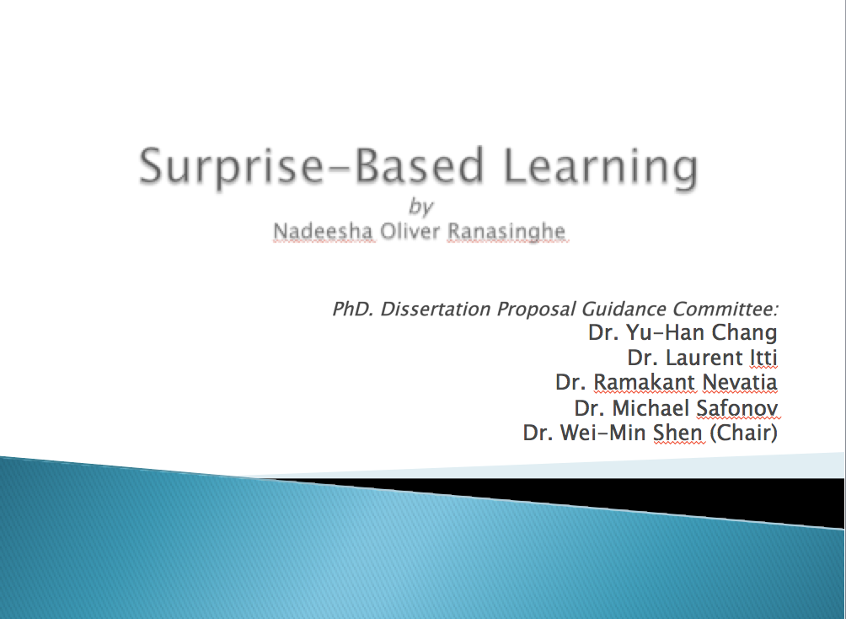
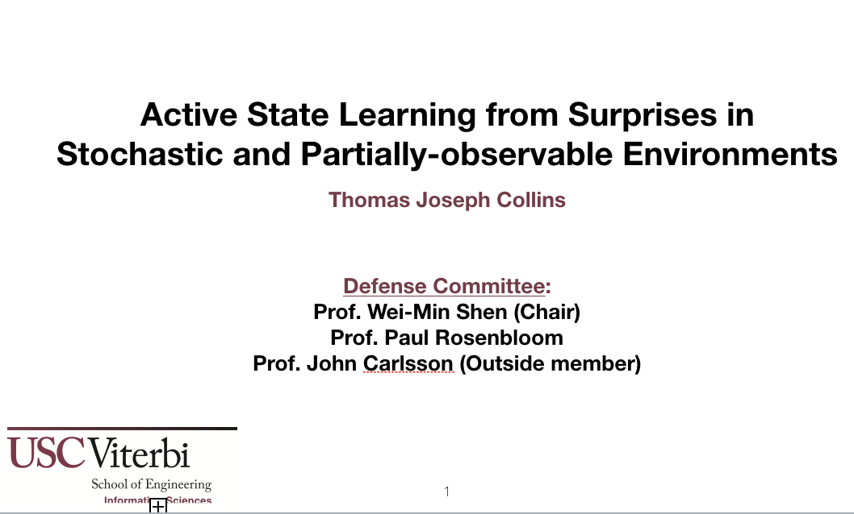
Surprise-Based Learning
Herbert A. Simon (1916-2001)
Nobel Prize Winner (AI, Machine Discovery)
Wei-Min Shen (1983 – present)
Autonomous Learning from the Environment
Nadeesha Ranasinghe (2005 – present)
Learn and predict unexpected changes
Thomas J. Collins (2013 – present)
Discovery of hidden/latent structures

Slide 7
My Research on Data Mining
DataCrystal for knowledge discovery from big data (NSF)
Discovery hidden variables from complex systems (DARPA)
Human Meridian Energy Sensing & Harmonization (USC+)
Digital hormone for distributed device coordination (NASA)
Biological Morphogenesis and digital hormones (Patents)
Human health as a distributed, complex, intelligent system
Editorial Board Member, Handbook of Data Mining and Knowledge Discovery, Oxford University Press, 2001
NSF Panel Member on Data Mining
One of the early starters of KDD at AAAI 1992

Slide 8
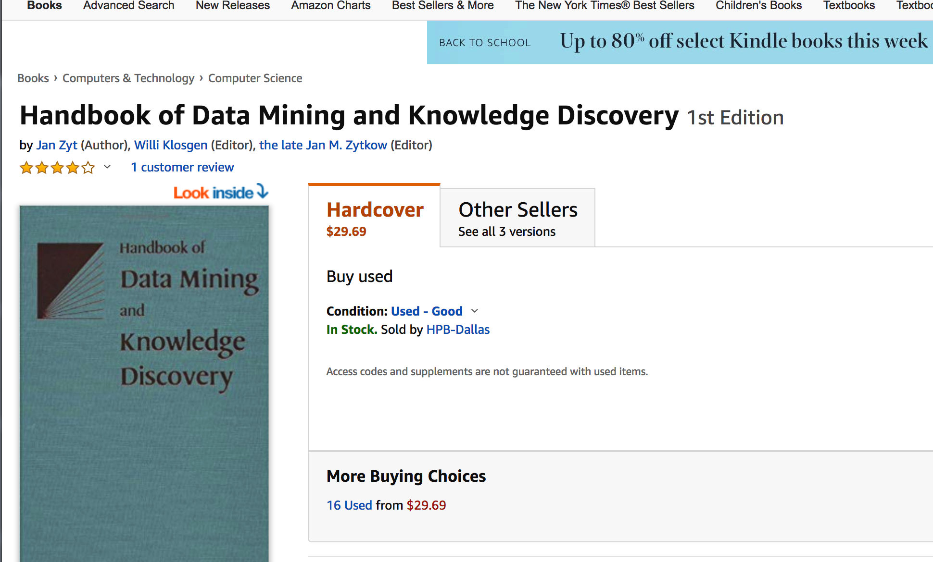
My Research on Data Mining

Slide 9
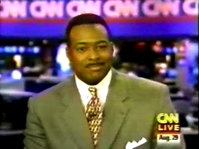
1997 RoboCup World Champion (CNN) (USC Dreamteam)
Notes:
USC Team first world Champions in robot soccer. Challenge to beat human champions by 2050. Video of first Sony Aibo

Slide 10
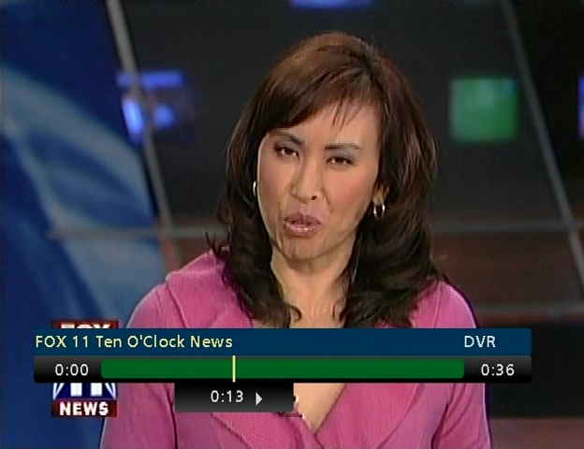
Introduction to SuperBot

Slide 11
Please introduce yourself !

Slide 12
What is Data Mining? About THIS Course

Slide 13
What is Data Mining? Knowledge Discovery from Data

Slide 14
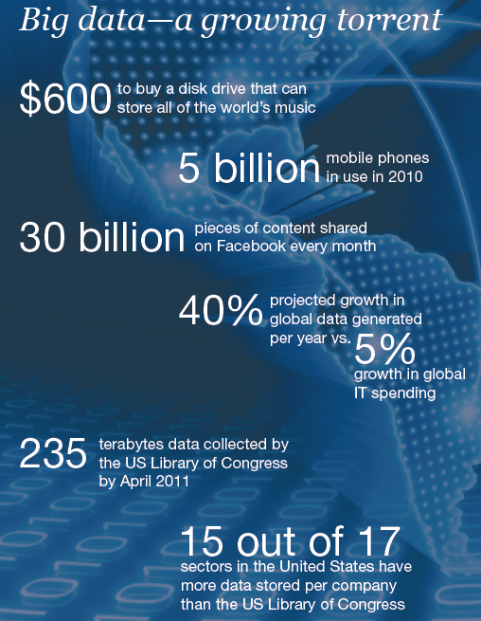
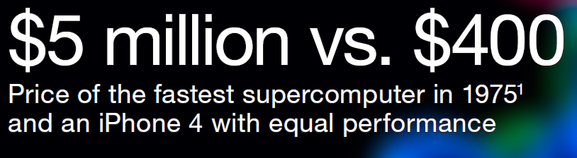

Slide 15

Data contains value and knowledge

Slide 16
Data Mining
But to extract the knowledge, data needs to be
Stored
Managed
And ANALYZED ← this class
Data Mining ≈ Big Data ≈ Predictive Analytics ≈ Data Science
Big Data Lifecycle

Slide 19
The Challenges of Big Data?
Cannot store in one place
Must be distributed
Failures for access may be unexpected
Unpredictable diversity
Messy, noisy, and errors are inevitable
Dynamic
……

Slide 20
What is Data Mining?
Given lots of data
Discover patterns and models that are:
Valid: hold on new data with some certainty
Useful: should be possible to act on the item
Unexpected: non-obvious to the system
Understandable: humans should be able to interpret the pattern

Slide 21
Data Mining Tasks
Descriptive methods
Find human-interpretable patterns that describe the data
Example: Clustering
Predictive methods
Use some variables to predict unknown or future values of other variables
Example: Recommender systems

Slide 22
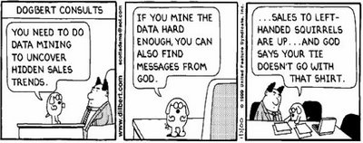
Meaningfulness of Analytic Answers
A risk with “Data mining” is that an analyst can “discover” patterns that are meaningless
Bonferroni’s principle:
If you look in more places for interesting patterns than your amount of data will support, you are bound to find crap

Slide 23
Meaningfulness of Analytic Answers
Example:
We want to find (unrelated) people who at least twice have stayed at the same hotel on the same day
10⁹ people being tracked – 1 billion
1,000 days ~ 3 years
Each person stays in a hotel 1% of time (1 day out of 100)
Hotels hold 100 people (so 10⁵ hotels)
enough to hold the 1% of a billion people who visit a hotel on any given day
If everyone behaves randomly will the data mining detect anything suspicious?

Slide 24
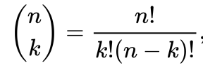
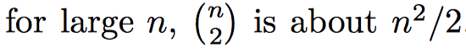
Meaningfulness of Analytic Answers (Cont’d)
10⁹ people, 1,000 days, 1% hotel stay, 10⁵ hotels
The probability of any two people both deciding to visit a hotel on any given day is 0.0001 (i.e., 1%*1%)
The chance that they will visit the same hotel for one day is 0.0001 /10⁵ = 10⁻⁹ ; for two given days = 10⁻¹⁸
The number of pairs of people is C(10⁹, 2) = 5 x 10¹⁷
The number of pairs of days is C(10³, 2) = 5 x 10⁵
Expected number of “suspicious” pairs of people:
5 x 10¹⁷ x 5 x 10⁵ x 10⁻¹⁸ = 250,000 (Wow! )
… too many combinations to check – we need to have some additional evidence to find “suspicious” pairs of people in some more efficient way

Slide 25
What matters when dealing with data?
Challenges
Usage
Quality
Context
Streaming
Scalability
Collect
Prepare
Text
Data
Modalities
Ontologies
Networks
Signals
Represent
Structured
Multimedia
Model
Reason
Visualize
Data Operators

Slide 26
Data Mining: Cultures
Data mining overlaps with:
Databases: Large-scale data, simple(r) queries
Machine learning: Small data, Complex models
CS Theory: Algorithms
Different cultures:
To a DB person, data mining is an extreme form of analytic processing – queries that examine large amounts of data
Result is the query answer
To a ML person, data-mining is the inference of models
Result is the parameters of the model
In this class we will do both!
CS Theory
Machine Learning
Data Mining
Database systems

Slide 27
About THIS Course

Slide 28
This Course
This course overlaps with machine learning, statistics, artificial intelligence, databases but more stress on
Scalability (big data)
Algorithms
Computing Architectures
Automatic Handling of large data
Statistics
Machine
Learning
Data Mining
Database systems

Slide 29
What will we learn?
We will learn to mine different types of data:
Data are high dimensional
Data are graphs
Data are infinite/never-ending
Data are labeled
We will learn to use different models of computation:
MapReduce
Streams and online algorithms
Single machine in-memory

Slide 30
What will we learn?
We will learn to solve real-world problems:
Recommender systems
Market Basket Analysis
Spam detection
Duplicate document detection
We will learn various “tools”:
Linear algebra (Recomm. Sys., Communities)
Optimization (stochastic gradient descent)
Dynamic programming (frequent itemsets)
Hashing (LSH, Bloom filters)

Slide 31
How It All Fits Together
High dim. data
Locality sensitive hashing
Clustering
Graph data
PageRank, SimRank
Community Detection
Infinite data
Filtering data streams
Web advertising
Dimensionality reduction
Spam Detection
Queries on streams
Machine learning
SVM
Decision Trees
Perceptron, kNN
Apps
Recommender systems
Association Rules
Duplicate document detection

Slide 32
Course Logistics
Course website: https://blackboard.usc.edu/
Lecture Notes on Piazza: /resources
Post on the same day of the lecture
Quizzes, Homework, Exam, Competition
Readings
Mining of Massive Datasets
J. Leskovec, A. Rajaraman and J. Ullman
Free online: http://www.mmds.org
Other relevant papers

Slide 33
Logistics: Communication
Discussion board on Piazza (Blackboard)
Please enroll yourself, and you are all invited on Piazza
Questions and public communication with the course staff
Help your fellow students by contributing answers What a friend is for!
a post on the discussion board

Slide 34
Logistics: Communication
We will post course announcements to
Piazza and Blackboard (please check regularly)
Emails:
Do not use emails unless it’s personal!

Slide 35
Work for the Course
Six homework: 42%
Programming assignments on Vocareum.com
MapReduce (2 weeks)
Frequent Itemsets (2 weeks)
Recommendation Systems (3 weeks***)
Detecting Communities in a Social Network (2 weeks)
Streaming data analysis (1 week)
Clustering big datasets (1 week)
Assignments take lots of time. Start early!!
One Grand Competition Project: 8% + bonus
Recommendation Systems
Please work on your own code!

Slide 36
Work for the Course
Homework policy:
On Vocareum.com
You can test and submit your code
Your work will be auto-graded by scripts
Be careful to use the exact formats!
No regrading
One week late penalty: –20%
0 points after one week
Free five-day extensions
Use the extension days on homework however you want
No more extension days will be given for any reason

Slide 37
Work for the Course
Final Project and Grand Competition
We will be building a recommendation system based on homework-3
You will continue improving your recommendation system (homework-3) throughout the course
Your recommendation system will compete with systems from:
Other students
TAs / Course Producers / Graders
Why are we doing the competition?

Slide 38
Work for the Course
Why are we doing the competition?
Learn how to handle real (big) datasets, e.g.,
http://grouplens.org/datasets/movielens/
You will have the opportunity to put something like this on your resume:
First Place, USC Data Mining Competition (2021)
I will have something to say if you want me to be your reference ☺

Slide 39
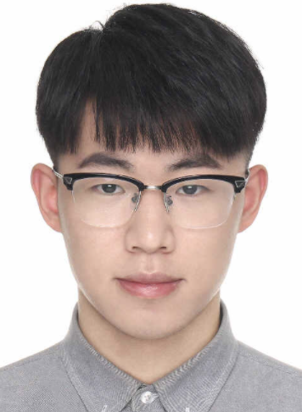
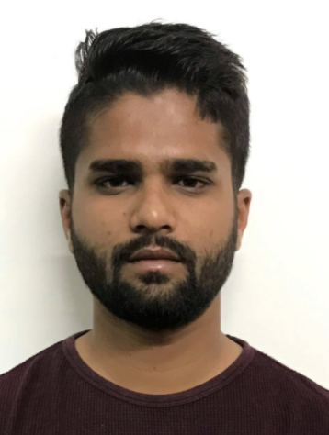
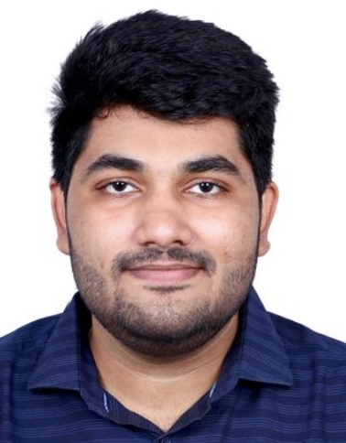
Previous Winners (2021 Fall)
USC Data Mining Competition
Li WenXuan (your TA)
Daniel Hao
Tirth Patel (your TA)
Dhruvil Anil Trivedi
Vishal Ajaybhai Kapadia (your TA)
Deep Prakash Amin

Slide 40
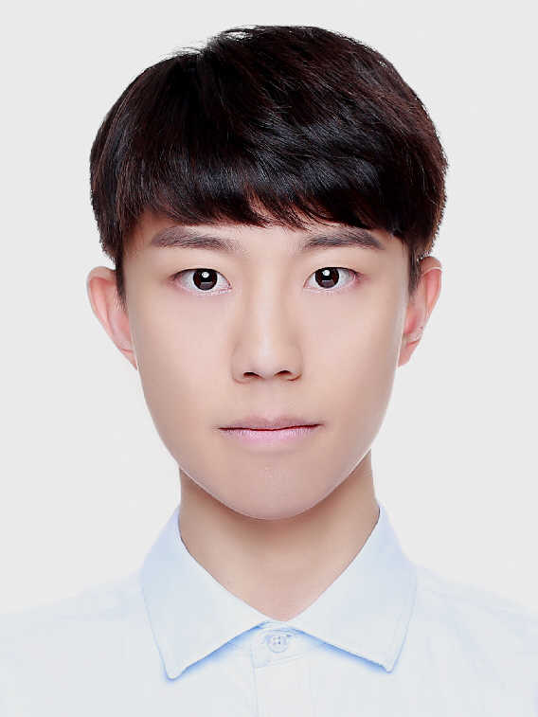
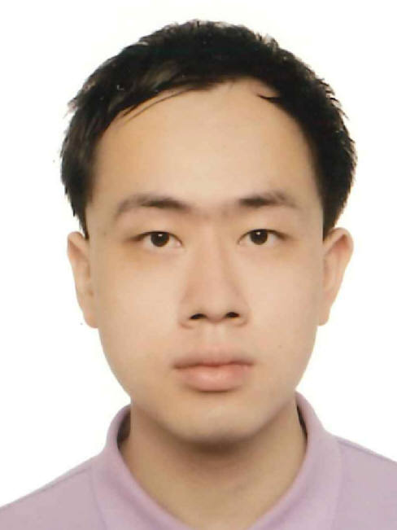

Previous Winners (2021 Spring)
USC Data Mining Competition
Zeyang Gong (0.9721) (your TA)
Jiemin Tang (0.9744)
Nitin Chandra Perumandl (0.9745)
Shiyang Chen (0.9749)
Matheus Schmitz (0.9750)
Yuxin Jiang (0.9752)

Slide 41
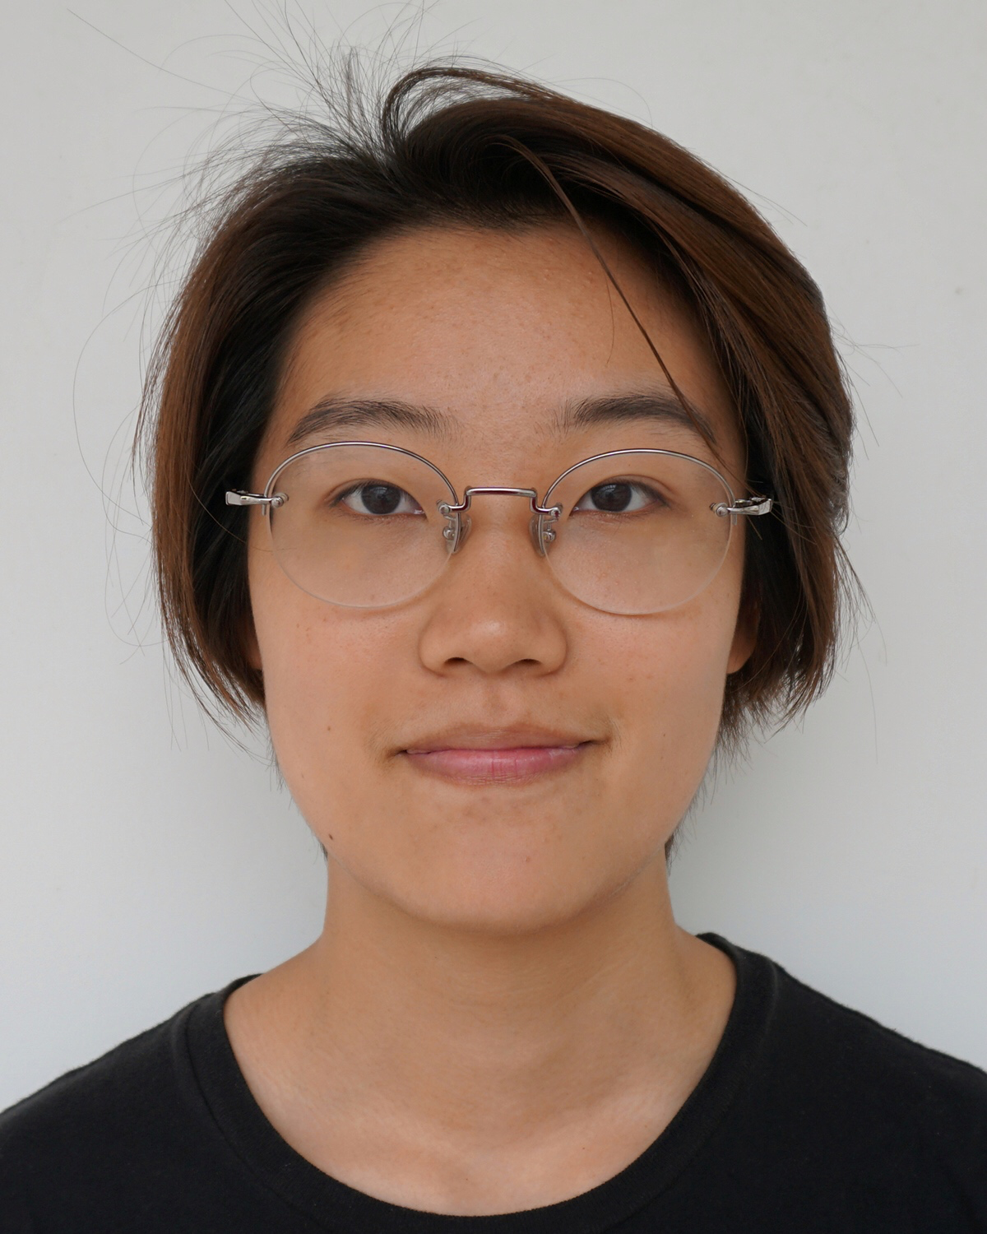
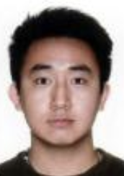
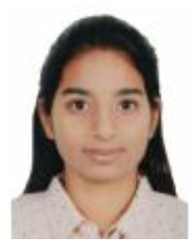
Previous Winners (2019)
USC Data Mining Competition
First Place, Yang Zheng
Second Place, Peilun Yan
Third Place, Nivedetha Kumaram

Slide 42
Previous Winners (2018)
USC Data Mining Competition
First Place, Hongtao Yang
Second Place, Chen Lou
Third Place, Bufan Zeng

Slide 43
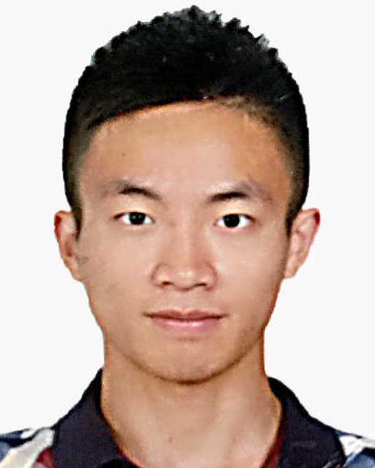
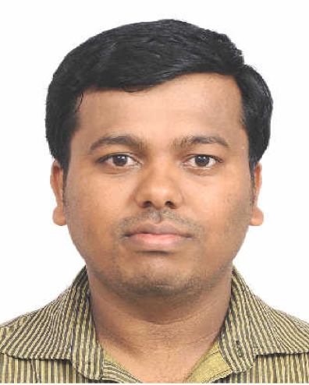
Previous Winners (2017)
USC Data Mining Competition
First Place, Priyambada Jain
Second Place, Zihao Zhai
Third Place, Vijayakumar Gedigeri

Slide 44
Work for the Course
Not-So-Short weekly quizzes: 30%
Not-So-Short in-class quizzes every week
Covers the material learned in the previous week
You may drop one/two your lowest quizzes
Comprehensive exam: 20%
Tentative Date: Week16, 7:00 – 9:00 pm
The exam will cover everything taught in class
No final exam but the final project will due online at the scheduled final date / time
It’s going to be fun and hard work.

Slide 45
Quiz and Lecture (where and when)
6:45 PM (quiz group zoom)
Join you group zoom, report to your proctor TA
See Piazza posts for your group assignment
7:00-7:20 PM (quiz group zoom)
Quiz, using Lockdown Browser and Password
7:25 – 10:20PM (lecture zoom)
Join lecture zoom (follow link on Blackboard)
Notes
1/18 (practice quiz), 1/25 and after, real quizzes

Slide 46
Prerequisites
Algorithms
Dynamic programming, basic data structures, ….
Basic probability
Moments, typical distributions, MLE, …
Programming
Your choice, but Python will be very useful
Spark and/or Scala (for homework)
We provide some background, but the class will be fast paced

Slide 47
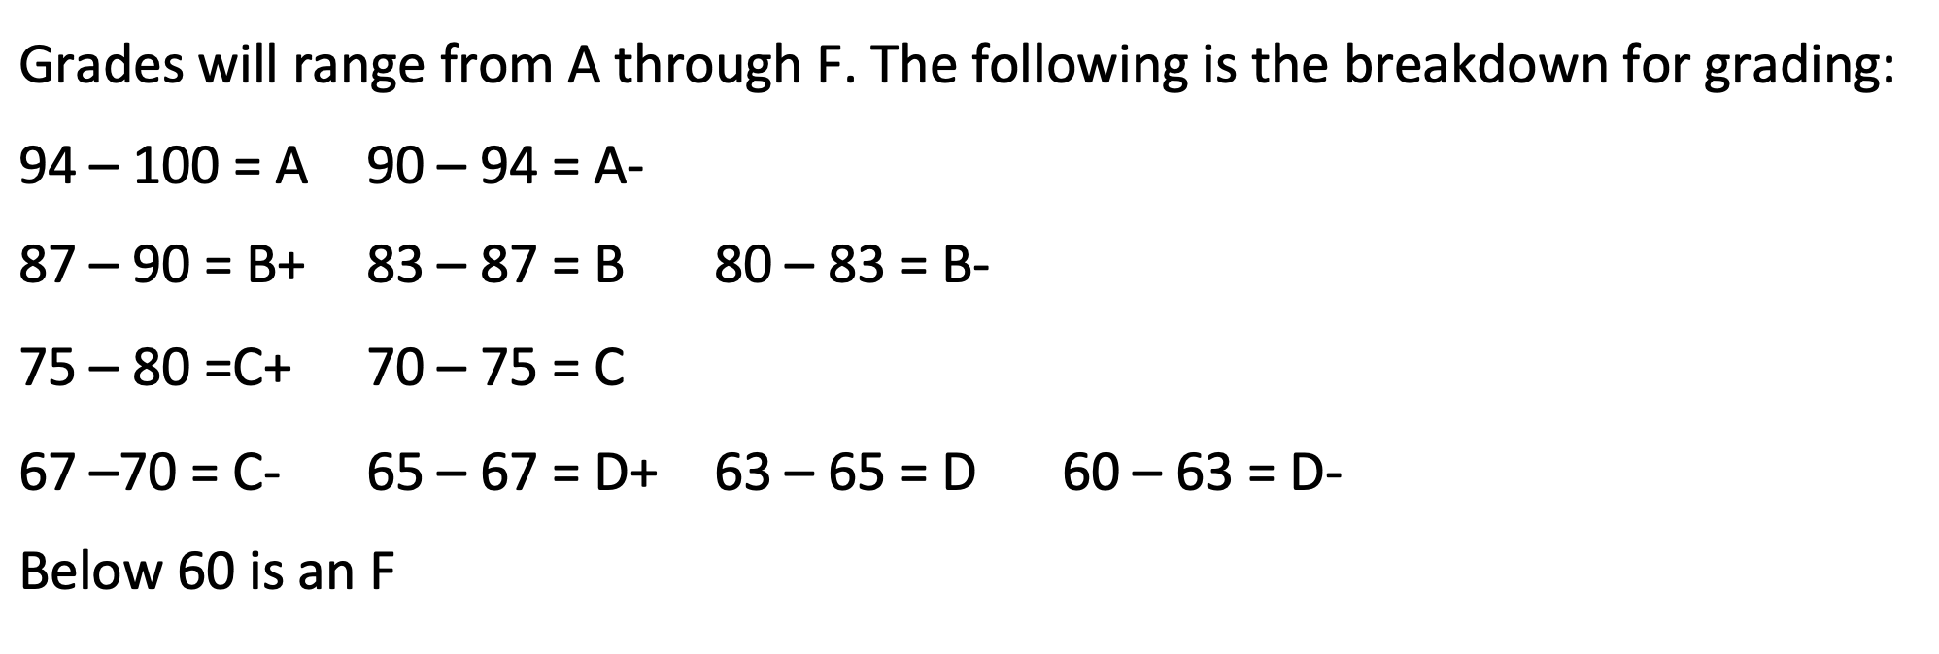
Course Grade

Slide 48
What’s After the Class?
Directed Research
Course producer or grader positions
Paid TA positions
Paid RA positions (maybe)

Slide 49
To-do items
Download the textbook
Install Spark on your machine (http://spark.apache.org/)
Get familiar with Vocareum and how to use the terminal window
Play with datasets http://grouplens.org/datasets/movielens/ and http://jmcauley.ucsd.edu/data/amazon/links.html

Slide 50

Schedule around Holidays
Alternate lecture days for a holiday
Please attend the lectures on the other lecture day
Study the slides and zoom videos yourself
Quizzes will start on the 3rd week (2nd week practice)
Zoom 15min before, quiz on time for 20 min, lectures
Please arrange your camera as this

Slide 51
About Auditing …
Auditing the class is fine if we have space
Please email me if you want to audit the class
Check with your advisor for the last day to drop a class without a mark of “W”

Slide 52
Some Backup Slides

Slide 53
My Other Research Topics
Biological morphogenesis
Self-organizing swarm robots and UAVs
Self-healing (scalable) systems
Underwater robotic swarm
Self-assembly in space
Oil and energy robotics
Self-configureble networks
Distributed Power/Resource Sharing
Evolution of brains
Surprise-Based Learning (SBL) discovering hidden variables

Slide 54

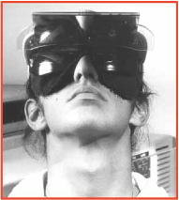

Why Surprise-Based Learning?
New Environment/Task → Learning → Knowledge/Skill
Key Idea: Detect and learn from “surprises”
Adaptive to new environments (no priori knowledge, “swim”)
Learn to accomplish new tasks (goals may change dynamically)
Self-heal unexpected failures or dynamics (e.g., inverted visions)
Know-how → Surprises → Learn → Recovery
Human health as a complex system to be discovered

Slide 55
Machine Learning and Discovery
Supervised Learning
Unsupervised Learning
Type I: Clustering the data
Automatically group the data into clusters
Type II: Parameter Learning (states are known)
Learn transitions, sensor models, & current state
Type III: Structural & non-parametric Learning
States have internal structures (not just “symbols”)
States are not known and must be learned
Machine Discovery

Slide 56
SBL Objectives
Autonomously extracts the states and corresponding state machines from the interactive experience with the environment
Number of states, observed features of states & transitions between states are not necessarily known or predetermined
Top-down approach to meet low-level sensor measurements and evidences
Learn the structure of states for description while detecting, explaining and learning from surprises in the experience
“Surprise” connects to “anomaly” and “unexpected interference”
End-to-end Learning
Life-long Learning
Incremental and online learning

Slide 57
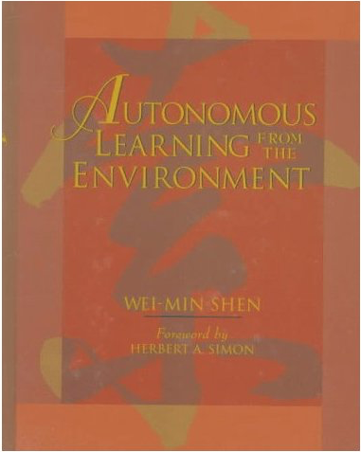
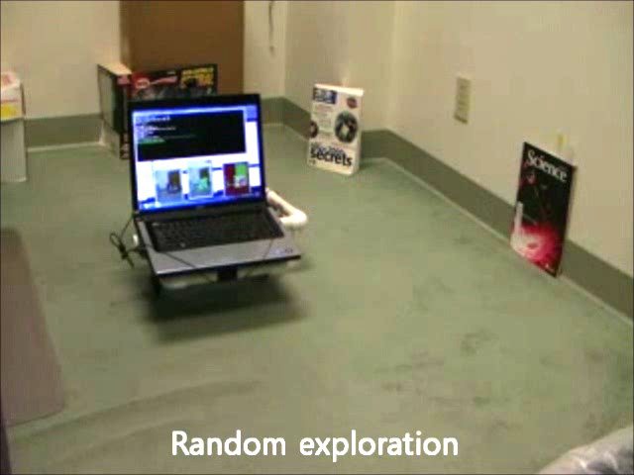
Surprise-Based Learning (Structure)
Perception
observation
Surprise
Analyzer
prediction
Predictor
TASK/ENVIRONMENT
(BLACK BOX)
Model Modifier
Model Synchronizer
Model
actions
Plan
Action Selector
(Planner)
Goals (Intensions)
The Learner continuously makes predictions, detects surprise, analyzes surprises, extracts critical information from surprises, and improves and use its action models to achieve goals
Surprise ==> Model ==> Prediction

Slide 58
Surprise Types and Key Problems
Types of surprise
Unexpected failures
Unexpected successes
Null prediction surprise
When there is no a priori model
Differentiate “new information” from noise
Focus attention on the relevant features
Seek differences that are statistically significant

